Slide 1
AI RNN LSTM

Slide 2
source
https://dennybritz.com/posts/wildml/recurrent-neural-networks-tutorial-part-1/
https://www.youtube.com/watch?v=yZv_yRgOvMg

Slide 3
RNN Application
Recurrent neural networks (RNNs) shine in tasks involving sequential data, where order and context are crucial.
What is sequence?
English -> I feel like flying today. So lets go do some para jumping
Time series -> series of data with time-stamp: <2020-01, ‘$2’>, <2020-02, ‘$3’>, <2020-03, ‘$3’>,…
Let’s explore some real-world use cases of RNN.
Speech Recognition: RNNs power virtual assistants like Siri and Alexa, allowing them to understand spoken language and respond accordingly.
Machine Translation: RNNs translate languages more accurately, like Google Translate by analysing sentence structure and context.
Text Generation: RNNs are behind chatbots that can hold conversations and even creative writing tools that generate different text formats.
Time Series Forecasting: RNNs analyze financial data to predict stock prices or weather patterns based on historical trends.
Music Generation: RNNs can generate music by learning patterns from existing pieces and generating new melodies or accompaniments.
Video Captioning: RNNs analyze video content and automatically generate captions, making video browsing more accessible.

Slide 4
Why can't we use a plain ANN for time series forecasting?
Short answer: Because ANN doesn't remember the past.
No memory of past inputs: ANN treats every input independently, it doesn’t remember what happened before.
No temporal ordering: ANN sees data points randomly; time order (yesterday → today → tomorrow) is not naturally handled.
Fixed-size input: ANN expects all inputs to have a fixed shape. Time series may grow or shrink dynamically.
Lag features must be hand-crafted: To make ANN "see the past", you have to manually create "lag features" (previous values), which gets messy for long dependencies.

Slide 5
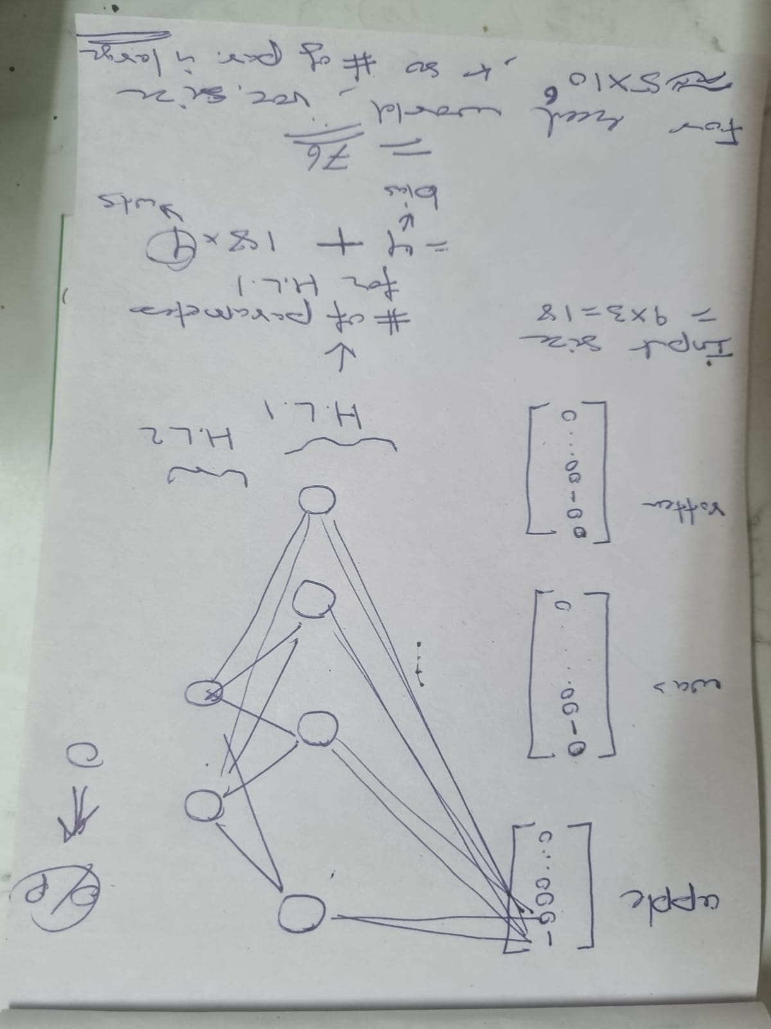
Why we cannot use ANN for sentiment analysis?
Sentence | Is_happy
apple was rotten | n
apple was fresh | y
I was disappointed by apple | n
apple tasted sweet | y
Here vocab. size = 9:
Vocabulary = (apple, was, rotten, fresh, tasted, sweet, I, disappointed, by).
apple: (1, 0, 0, 0, 0, 0 , 0, 0, 0 )
was: (0, 1, 0, 0, 0, 0 , 0, 0, 0 )
tasted: (0, 0, 0, 0, 1, 0 , 0, 0, 0 )
Rotten: (0, 0, 1, 0, 0, 0 , 0, 0, 0 )
1) When sentence is ‘apple was rotten’, then size of input layer is
= number of words in sent. X vocab. Size
= 3 X 9 = 18.
The number of param in HL1 is
= num_of_bias_terms + input_size * num_of_wts_from_each_input
= 4 + 18*4 = 76
In real world, vocab size is around 5 million. So number of param would be large => computational complexity increases for ANN.
2) The size of input is not fixed:
“apple was rotten” needs 3*9=18 inputs
“I was disappointed by apple” needs 5*9=45 inputs. ANN would not be able work with this type of varying input-size scenario. So padding of 0 was used to make it fixed size input….but this in turn would lead to unnecessary large number of 0 causing sparsity.
3) “Dog was chased by cat” and “cat was chased by dog”. The ANN would treat both as same sentence but they have semantically different meaning.

Slide 6
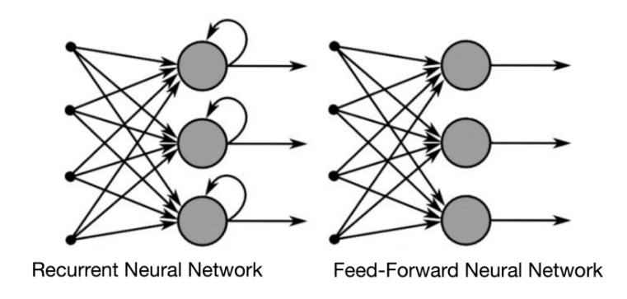
Theory
A recurrent neural network (RNN) is the type of artificial neural network (ANN) that is used in Apple’s Siri and Google’s voice search.
RNN has a short-term memory. RNN remembers past inputs due to an internal memory which is useful for predicting stock prices, generating text, transcriptions, and machine translation.
In the traditional neural network, the inputs and the outputs are independent of each other, whereas the output in RNN is dependent on prior elementals within the sequence. Recurrent networks also share parameters across each layer of the network.
RNNs are a type of neural network that can model sequence data. RNNs, which are formed from feedforward networks, are similar to human brains in their behaviour. Simply said, recurrent neural networks can anticipate sequential data in a way that other algorithms can’t. All of the inputs and outputs in standard neural networks are independent of one another. However, in some circumstances, such as when predicting the next word of a phrase, the prior words are necessary, and so the previous words must be remembered. As a result, RNN was created, which used a hidden layer to overcome the problem. The most important component of RNN is the hidden state, which remembers specific information about a sequence.
For more read: https://www.geeksforgeeks.org/introduction-to-recurrent-neural-network/

Slide 7
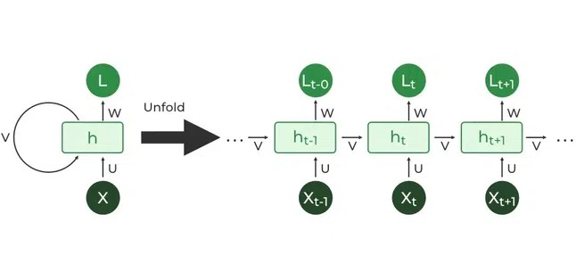
Architecture
RNNs are a type of neural network with hidden states and allow past outputs to be used as inputs. Here’s a breakdown of its key components:
Input Layer: This layer receives the initial element of the sequence data. For example, in a sentence, it might receive the first word as a vector representation.
Hidden Layer: The heart of the RNN, the hidden layer contains a set of interconnected neurons. Each neuron processes the current input along with the information from the previous hidden layer’s state. This “state” captures the network’s memory of past inputs, allowing it to understand the current element in context.
Activation Function: This function introduces non-linearity into the network, enabling it to learn complex patterns. It transforms the combined input from the current input layer and the previous hidden layer state before passing it on.
Output Layer: The output layer generates the network’s prediction based on the processed information. In a language model, it might predict the next word in the sequence.
Recurrent Connection: A key distinction of RNNs is the recurrent connection within the hidden layer. This connection allows the network to pass the hidden state information (the network’s memory) to the next time step. It’s like passing a baton in a relay race, carrying information about previous inputs forward

Slide 8
RNN
RNN incorporates loops that allow information from previous steps to be fed back into the network. This feedback enables RNNs to remember prior inputs making them ideal for tasks where context is important.

Slide 9
RNN: Feed Forward Propagation (TODO from Batch9)

Slide 10
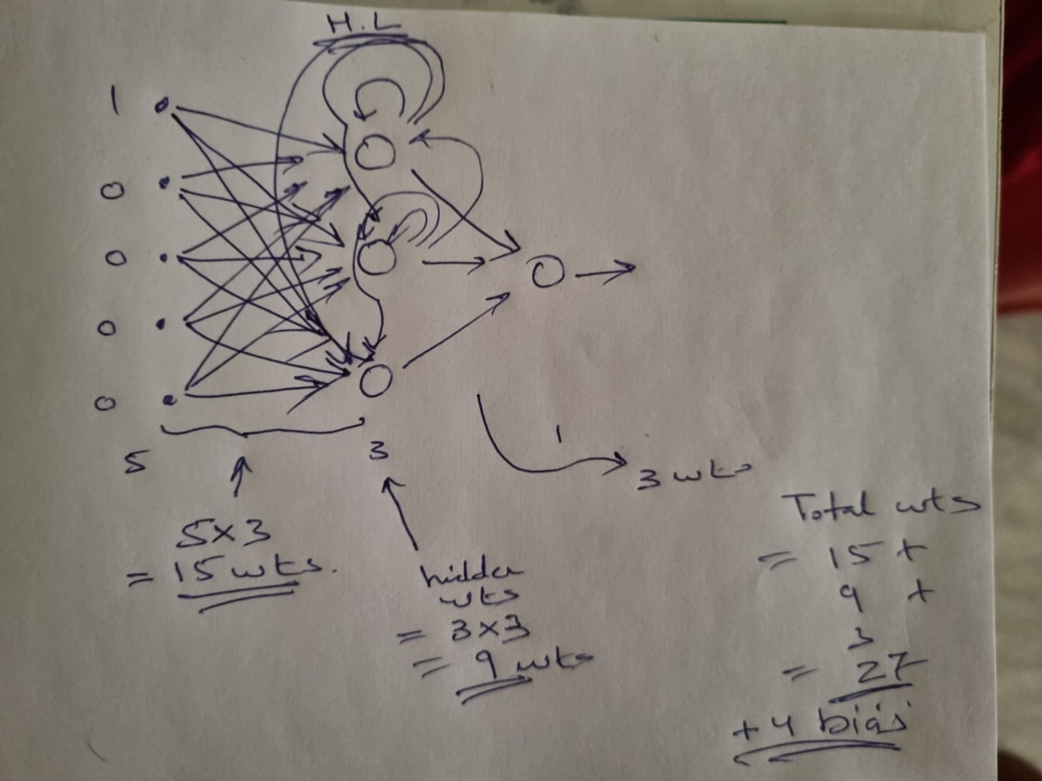
RNN: How many parameters(wts+bias) ? Ans: 27+4=31

Slide 11
RNN: Back propagation Theory(TODO)

Slide 12
Key properties of RNN
Recurrent neural networks (RNNs) set themselves apart from other neural networks with their unique capabilities:
Internal Memory: This is the key feature of RNNs. It allows them to remember past inputs and use that context when processing new information.
Sequential Data Processing: Because of their memory, RNNs are exceptional at handling sequential data where the order of elements matters. This makes them ideal for speech recognition, machine translation, natural language processing (NLP) and text generation.
Contextual Understanding: RNNs can analyze the current input in relation to what they’ve “seen” before. This contextual understanding is crucial for tasks where meaning depends on prior information.
Dynamic Processing: RNNs can continuously update their internal memory as they process new data, allowing them to adapt to changing patterns within a sequence.

Slide 13
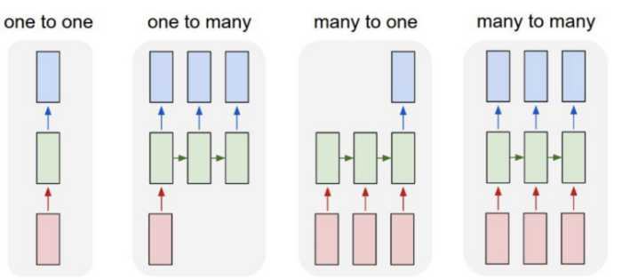
Types of RNN
One-to-one RNN models have one input and one output. One-to-one architecture is used in traditional neural networks and for general machine learning tasks like image classification.
One-to-many RNNs have one input and several outputs. This enables image captioning or music generation capabilities, as it uses a single input (like a keyword) to generate multiple outputs (like a sentence).
Many-to-one model has several inputs and one output. Tasks like sentiment analysis or text classification often use many-to-one architectures. For example, a sequence of inputs (like a sentence) can be classified into one category (like if the sentence is considered a positive/negative sentiment).
Many-to-many models map several inputs to several outputs. Machine translation and name entity recognition are powered by many-to-many RNNs, where multiple words or sentences can be structured into multiple different outputs (like a new language or varied categorizations).

Slide 14
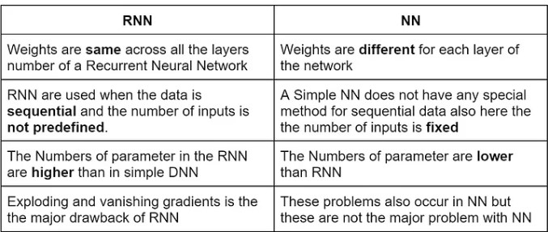
Difference between RNN and simple NN

Slide 15
Differences Between RNN and CNN
CNN is applicable for sparse data like images. RNN is applicable for time series and sequential data.
While training the model, CNN uses a simple backpropagation and RNN uses backpropagation through time to calculate the loss.
RNN can have no restriction in length of inputs and outputs, but CNN has finite inputs and finite outputs.
CNN has a feedforward network and RNN works on loops to handle sequential data.
CNN can also be used for video and image processing. RNN is primarily used for speech and text analysis.

Slide 16
Disadvantages of RNN(p1)
1 . Limited Memory and Difficulty with Long Sequences:
Explanation:
RNNs are good for short-term dependencies (e.g., "The cat sat"). They struggle when important information is far back in time (long-term dependency).
Basic RNNs have limited memory, making it difficult to remember and process information from previous time steps, especially when dealing with long sequences.
Example: “Today is Diwali, a festival that is celebrated by millions of people across different countries with lamps, fireworks, sweets, decorations, and family gatherings, bringing joy and brightness everywhere. This occasion … ”
Main subject = "Today is Diwali"
But important information ("Diwali") is hidden behind lots of extra words (celebrated by millions, across countries, lamps, sweets, decorations, gatherings...).
By the time the model reaches “This occasion", a basic RNN might forget that it all started with "Diwali" and context is “Diwali” and not "countries" or "families".
Cause:
Meaning/context is "diluted" as time steps increase:
The RNN's architecture, which is designed to capture immediate past dependencies, struggles to retain information from distant time steps. In a standard RNN, each hidden state only passes information to the next step.
As more steps pass, the important signal fades (this is called vanishing gradient during training), i.e. RNNs lose important early information over long sequences.

Slide 17
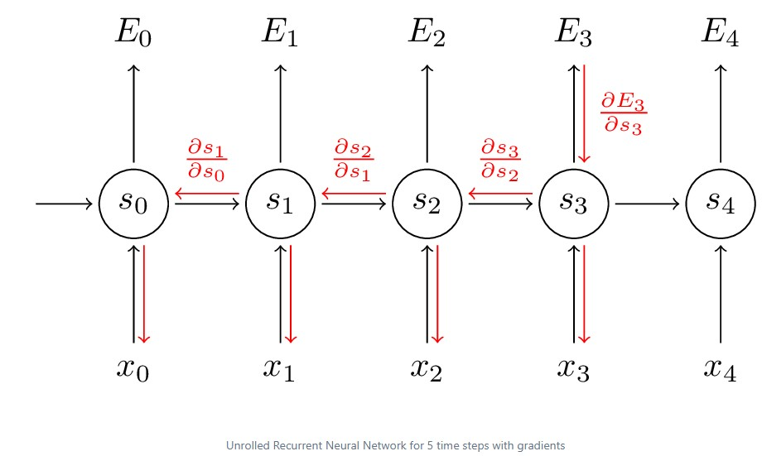
Disadvantages of RNN(p2)
Source: https://dennybritz.com/posts/wildml/recurrent-neural-networks-tutorial-part-3/
Understanding the math of vanishing gradient problem during training:
During training, RNN uses backpropagation through time (BPTT) to update weights by moving backward across many time steps.
At each step, gradients (tiny error signals) are multiplied by the weights repeatedly as they flow backward.
If the weights are small (e.g., 0.5), then multiplying many times makes gradients shrink exponentially toward zero.
When gradients become very tiny, they stop updating the early layers (the start of the sequence) — this is vanishing gradients.
As a result, the RNN forgets long-term information because the model can't learn from early parts of the sequence.
Backpropagation plays the key role because it is the process that moves error signals backward, causing the repeated shrinking that leads to this problem.
Backpropagation + many time steps + small weights = vanishing gradient = RNN forgets long-term memory.
Read Source: https://dennybritz.com/posts/wildml/recurrent-neural-networks-tutorial-part-3

Slide 18
Disadvantages of RNN(p3)
2. Unidirectional in RNN
RNN takes data sequentially and word by word or letter by letter. Now when we are trying to predict a particular word we are not thinking about its future context
Example : “Mouse is really good. The mouse is used to ____ for the easy use of computers.” Now if we can travel bidirectional and we can also see future context we may say ‘Scroll’ is the appropriate word here. But, if it’s unidirectional, our model has never seen computers so how does it know if we are talking about the animal mouse or computer mouse.
These problems are solved later using language models like BERT where we can input complete sentences and use the self-attention mechanism to understand the context of the text.

Slide 19
Disadvantages of RNN(p4)
3. Computationally slower than other neural network architectures. The reasons are
a) Sequential Dependency: In RNNs, each output depends on the previous output — you can't compute all time steps at once.
➔ You must go one step at a time, in order, which prevents parallel processing.
b) Backpropagation Through Time (BPTT): Training an RNN requires unrolling the network across many time steps and back propagating through each.
➔ This makes training longer and memory-intensive compared to a simple backward pass in a feedforward network.
c) Long Sequences: If the sequence is long (e.g., 1000 words), the model must do 1000 sequential calculations instead of processing all words at once like a CNN or Transformer could.
d) Gradient Issues: Due to vanishing or exploding gradients, RNNs often need smaller learning rates, gradient clipping, or careful initialization, slowing down training further.
RNN is slower because it is sequential and depends on past computations, while normal feedforward networks (like CNNs or MLPs) can work on all parts in parallel.
Feedforward networks (MLPs, CNNs) process inputs all at once — they don't depend on previous steps.
Suppose you have 1000 words or pixels.
A feedforward network takes all 1000 together, passes them through layers at the same time (matrix multiplication).
In math terms: matrix × vector — super fast because modern hardware (like GPUs) is built for parallel matrix operations.
No waiting for "previous word" or "previous pixel" — everything is independent at each layer.
This is called parallelism.

Slide 20
LSTM
LSTM is a specific type of RNN (Recurrent Neural Network) designed to address the limitations of standard RNNs, particularly in handling long-term dependencies in sequential data. While both RNNs and LSTMs are designed for processing sequential information, LSTMs use a more sophisticated architecture with "gates" to control the flow of information, allowing them to better remember (and forget) relevant information over long periods of time.
That's why LSTM (Long Short-Term Memory) and GRU networks were invented!
They are special types of RNNs that can carry long-term information much better.

Slide 21
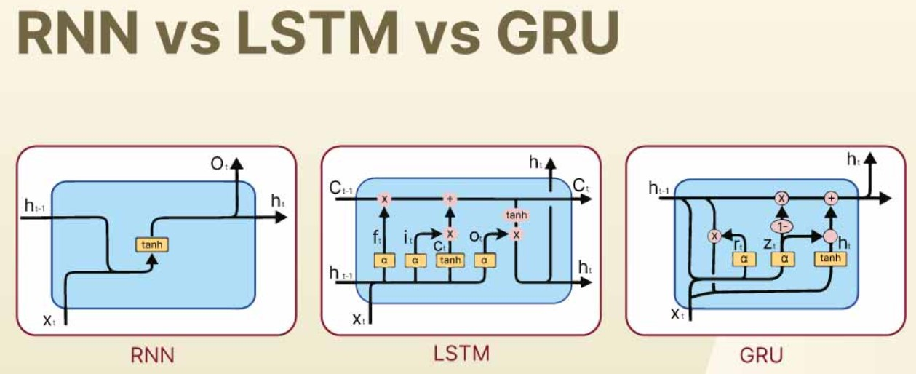

Slide 22
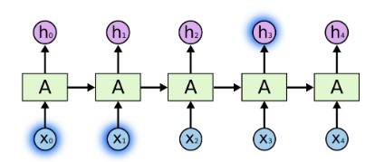
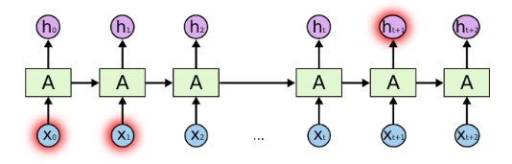
LSTM Architecture(p1):
source https://colah.github.io/posts/2015-08-Understanding-LSTMs/
The Problem of Long-Term Dependencies:
Sometimes, we only need to look at recent information to perform the present task. For example, consider a language model trying to predict the next word based on the previous ones. If we are trying to predict the last word in “the clouds are in the sky,” we don’t need any further context – it’s pretty obvious the next word is going to be sky. In such cases, where the gap between the relevant information and the place that it’s needed is small, RNNs can learn to use the past information.
But there are also cases where we need more context. Consider trying to predict the last word in the text “I grew up in France… I speak fluent French.” Recent information suggests that the next word is probably the name of a language, but if we want to narrow down which language, we need the context of France, from further back. It’s entirely possible for the gap between the relevant information and the point where it is needed to become very large.
Unfortunately, as that gap grows, RNNs become unable to learn to connect the information
In theory, RNNs are absolutely capable of handling such “long-term dependencies.” A human could carefully pick parameters for them to solve toy problems of this form. Sadly, in practice, RNNs don’t seem to be able to learn them. The problem was explored in depth by Hochreiter (1991) [German] and Bengio, et al. (1994), who found some pretty fundamental reasons why it might be difficult.
Thankfully, LSTMs don’t have this problem!

Slide 23
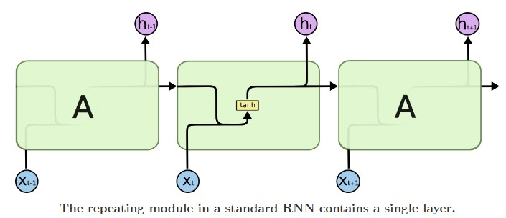
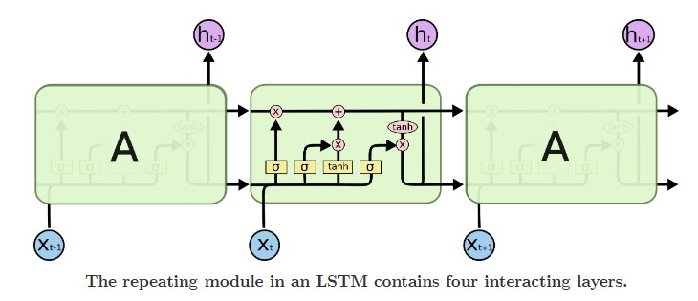

LSTM Architecture(p2):
source https://colah.github.io/posts/2015-08-Understanding-LSTMs/
LSTM Networks
Long Short Term Memory networks – usually just called “LSTMs” – are a special kind of RNN, capable of learning long-term dependencies. They were introduced by Hochreiter & Schmidhuber (1997), and were refined and popularized by many people in following work.¹ They work tremendously well on a large variety of problems, and are now widely used.
LSTMs are explicitly designed to avoid the long-term dependency problem. Remembering information for long periods of time is practically their default behavior, not something they struggle to learn!
All recurrent neural networks have the form of a chain of repeating modules of neural network. In standard RNNs, this repeating module will have a very simple structure, such as a single tanh layer.
LSTMs also have this chain like structure, but the repeating module has a different structure. Instead of having a single neural network layer, there are four, interacting in a very special way.
Don’t worry about the details of what’s going on. We’ll walk through the LSTM diagram step by step later. For now, let’s just try to get comfortable with the notation we’ll be using.
In the above diagram, each line carries an entire vector, from the output of one node to the inputs of others. The pink circles represent pointwise operations, like vector addition, while the yellow boxes are learned neural network layers. Lines merging denote concatenation, while a line forking denote its content being copied and the copies going to different locations.

Slide 24
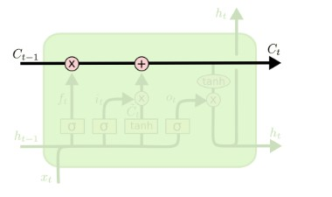
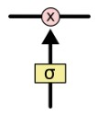
LSTM Architecture(p3):
source https://colah.github.io/posts/2015-08-Understanding-LSTMs/
The Core Idea Behind LSTMs
The key to LSTMs is the cell state, the horizontal line running through the top of the diagram.
The cell state is kind of like a conveyor belt. It runs straight down the entire chain, with only some minor linear interactions. It’s very easy for information to just flow along it unchanged.
The LSTM does have the ability to remove or add information to the cell state, carefully regulated by structures called gates.
Gates are a way to optionally let information through. They are composed out of a sigmoid neural net layer and a pointwise multiplication operation.
The sigmoid layer outputs numbers between zero and one, describing how much of each component should be let through. A value of zero means “let nothing through,” while a value of one means “let everything through!”
An LSTM has three of these gates, to protect and control the cell state.

Slide 25
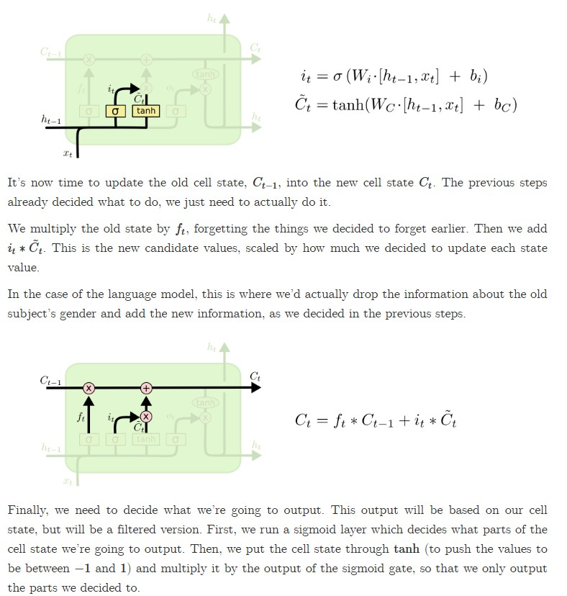
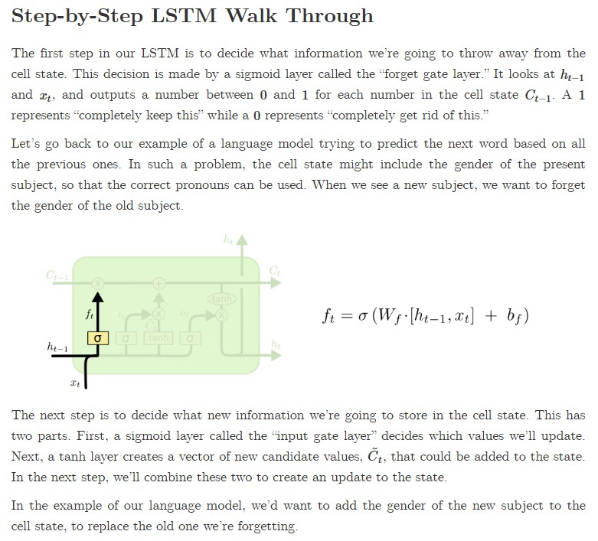
LSTM Architecture(p4):
source https://colah.github.io/posts/2015-08-Understanding-LSTMs/
Continued next page

Slide 26
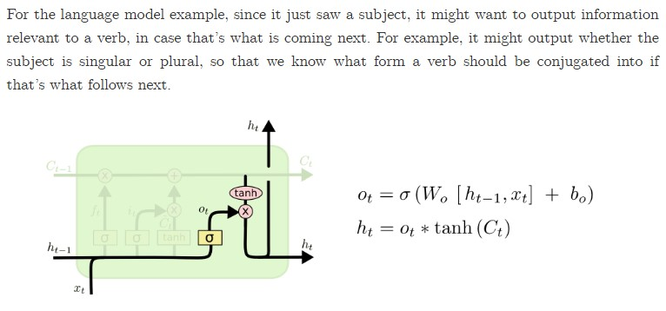
LSTM Architecture(p5):
source https://colah.github.io/posts/2015-08-Understanding-LSTMs/

